Slide 1

Scripting Languages
Regular Expression
Georges Khazen
Fall 2013

Slide 2
What are Regular Expressions
Patterns of characters that match, or fail to match, sequences of characters in text.
They have their own syntax (way of writing) where certain characters and combinations of characters have special meanings and uses.
Also referred to as regexp, regex, re or even grep

Slide 3
Applications
Finding doubled words
the quick brown fox fox jumps over the the lazy dog → the quick brown fox jumps over the lazy dog
Validating input
Web based forms
Traditional GUI forms
Changing formats
Dates: 5/16/78 → 05-16-1978
Phone numbers: 123-456-7890 → (123) 456-7890
Fixing case issues
the latest version of the Javascript language is javascript 1.7 → the latest version of the JavaScript language is JavaScript 1.7
HTML-ifying documents
Visit http://www.w3.org/ for more information → Visit <a href="http://www.w3.org/">http://www.w3.org/</a> for more information

Slide 4
Applications
Search and replace
Dealing with files:
    rm *.html
    ls ??.pl
Searching online

Slide 5
Not user friendly
Cryptic
Whitespace sensitive
Often case sensitive
Often takes time to fine tune the regular expression, it tends to be an iterative process
Multiple solutions for a given problem

Slide 6
CAn be used in
Scripting languages
  Perl
  Python
  PHP
  JavaScript
  Ruby
  Tcl
  Visual Basic
  .....
System Languages
  C/C++
  C#
  Java
Unix
  grep
  awk
  sed
  shell (bash, csh, tcsh, sh, ...)
Editors
  emacs/xemacs
  vi
  Open office

Slide 7
Regular Expressions
A formal language for specifying text strings
How can we search for any of these?
Woodchuck
Woodchucks
woodchuck
woodchucks

Slide 8
Regular Expressions: Disjunctions
Letters inside square brackets [ ]
Ranges
Pattern | Matches
[wW]oodchuck | Woodchuck, woodchuck
[1234567890] | Any digit
Pattern | Matches | Example
[A-Z] | An upper case letter | Drenched Blossoms
[a-z] | A lower case letter | my beans were impatient
[0-9] | A single digit | Chapter 1: Down the Rabbit Hole

Slide 9
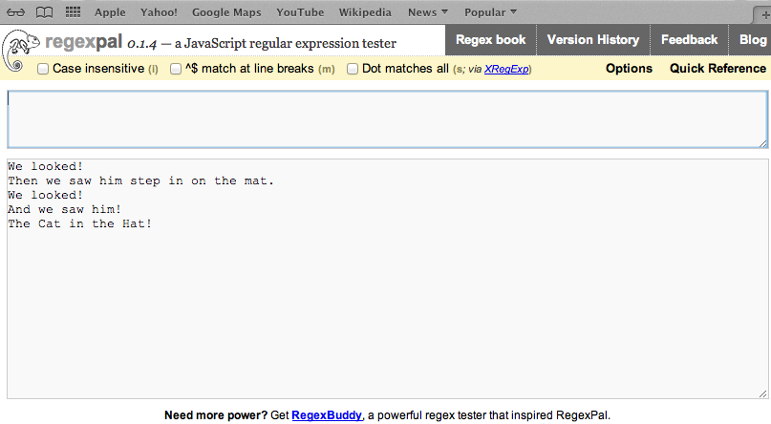
Regexpal Example
Examples: [Ww], [em], [A-Z], [a-z], [A-Za-z], [ !]

Slide 10
Regular Expressions: Negation in Disjunction
Negation [^Ss]
  caret means negation only when first in [ ]
Pattern | Matches | Example
[^A-Z] | Not an upper case letter | Oyfn pripetchik
[^Ss] | Neither “S” nor “s” | I have no exquisite reason
[^e^] | Neither “e” nor “^” | Look here
a^b | The pattern a caret b | Look up a^b now

Slide 11
Regexpal Example
Examples: [^A-Z], [^!], [^A-za-z], ^

Slide 12
Regular Expression: More Disjunction
Woodchucks is another name for groundhog!
The pipe | for disjunction
Pattern | Matches
Groundhog|woodchuck
yours|mine | yours mine
a|b|c | [abc]
[gG]roundhog|[Ww]oodchuck

Slide 13
Regexpal Example
Examples: looked|step, at|look

Slide 14
Regular Expression: Special Characters
Special Characters for regular expression:
? * + .
Pattern | Matches
colou?r | Optional previous char | color colour
oo*h! | 0 or more of previous char | oh! oo! oooh! ooooh!
o+h! | 1 or more of previous char | oh! oo! oooh! ooooh!
baa+ |  | baa baaa baaaa baaaaa
beg.n | Any alpha numeric character | begin begun beg3n

Slide 15
Regular Expressions: Anchors ^ $
Pattern | Matches
^[A-Z] | Palo Alto
^[^A-Za-z] | 1 “Hello”
\.$ | The end.
.$ | The end? Then end!
^ Matches the beginning of the line
$ Matches the end of the line
\. If you are searching for the .
\b matching a boundary (digits, underscore, letters)
\B matching a non-boundary

Slide 16
Operators Hierarchy
Parenthesis ()
Counters * + ? {}
Sequences and anchors the ^my end$
Disjunction |
/the*/ matches theeee or thethe?

Slide 17
Regexpal Example
Examples: o+, ^[A-Z], [A-Z]$, !$, \., .
The other one there, the blithe one.
(Example: Search for “the”)

Slide 18
Example
Find all instances of the word “the” in a text.
  the
  Misses capitalized examples
  [tT]he
  Incorrectly returns other or blithe
  [^a-zA-Z][tT]he[^a-zA-Z]
  \b[tT]he\b

Slide 19
Errors
The process we just went through was based on fixing two kinds of errors
  Matching strings that we should not have matched (there, then, other)
    False positives (Type I)
  Not matching things that we should have matched (The)
    False negative (Type II)

Slide 20
Advanced operators
RE | Match
* | Zero or more occurrences of the previous char or expression
+ | One or more occurrences of the previous char or expression
? | Exactly zero or one occurrence of the previous char or expression
{n} | n occurrences of the previous char or expression
{n,m} | From n to m occurrences of the previous char or expression
{n,} | At least n occurrences of the previous char or expression

Slide 21
A more complex example
Suppose we want to build an application to help a user buy a computer on the Web. The user might want “any PC with more than 6 GHz and 256 GB of disk space for less than $1000”

Slide 22
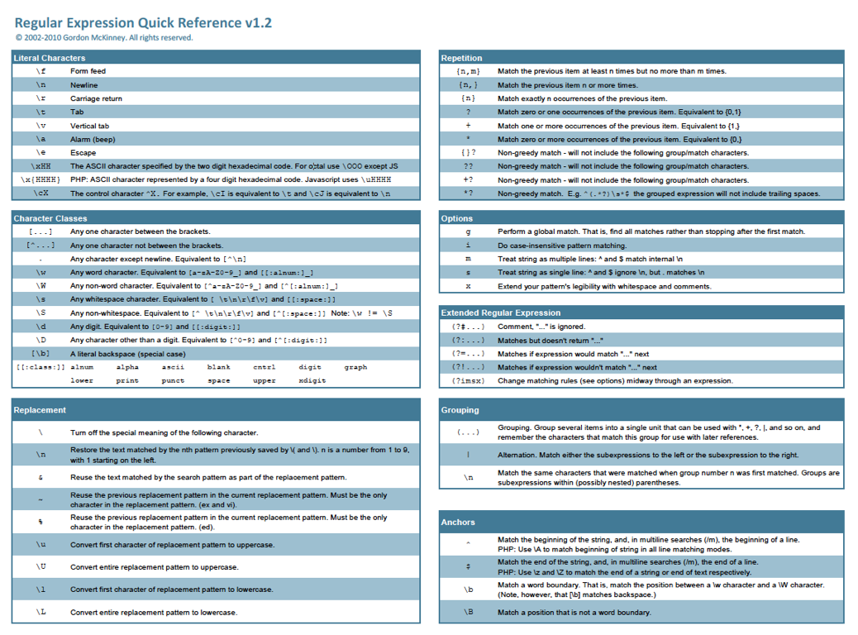
http://www.night-ray.com/regex.pdf

Slide 23
Terminologies
Literals and Meta-characters
  Most characters that appeal inside of regular expression are literals, they basically match themselves
  The characters that are exceptions are known as meta-characters. These characters have special meaning, can be used in different ways and do not match themselves directly.

Slide 24
Some Meta-Characters
{ } opening and closing curly braces
[ ] opening and closing square brackets
( ) opening and closing parenthesis
^ caret character
$ dollar sign
. dot/period
| vertical bar/pipe
* asetrisk
+ plus sign
? question mark
\ backslash

Slide 25
Single Character Patterns
The dot character . matches any single character except a new line
The square brackets [ ] , disjunction, specify a character class, a set of characters any one of which is a possible match. You can specify a range using -.
The caret character ^ is a meta character that has several meanings depending on the context. Inside the bracket it means a negation of everything inside the brackets

Slide 26
Advanced Operators
RE | Pattern | Match | Examples
\d | [0-9] | Any digit | Party of 5
\D | [^0-9] | Any non-digit | Blue moon
\w | [a-zA-Z0-9_] | Any alphanumeric/underscore | Daiyu
\W | [^\w] | A non-alphanumeric | !!!!!
\s | [ \r\t\n\f] | Whitespace (Space, tab)
\S | [^\s] | Non-whitespace | In concord

Slide 27
Grouping & Alternation
The pipe | is an alternation character. It is used to match different possible words or characters.
The parentheses () are used to group together parts of RE into a single unit.
  (a|b) # matches an "a" or "b" - same as [ab]
  (cat|dog) house # matches "cat house" or "dog house"
  (19|20|)\d\d # matches years "19xx", "20xx" or just "xx"

Slide 28
Quantifiers
These meta-characters allow you to specify some number of matches for a portion of a regular expression.
They are specified right after the character, character class of grouping you wish to look for.
? for 0 or 1 matches. This means the preceding item is optional
y(es)? # matches a "yes" or "y"
(y(es)?)|(n(o)?) # mathes "yes", "y", "no" or "n"
(19|20)?\d\d # matches "19xx", "20xx" or just "xx"

Slide 29
Quantifiers
The asterisk * matches the preceding item 0 or more times, any number of times
.* # matches anything, including empty string
f.*bar # matches "foobar", "fubar" or "fun at the bar"
m(iss)*ippi # matches "mississippi", "missippi" or "mippi"
The plus sign + matches the preceding item 1 or more times, at least once
[\da-fA-F]+ # matches 1 or more hex digits
m(iss)+ippi # matches "missippi" or "mississippi"

Slide 30
quantifiers
Specifying the exact number of matches can be done using the curly braces. They can take one of the 3 following forms:
{n} matches the preceding item exactly “n” number of times
{n,} matches the preceding item “n” or more number of times
{n,m} matches the preceding item between “n” and “m” number of times.
  m(iss){2}ippi # matches "mississippi"
  \d{3}-\d{3}-\d{4} # much improved phone number
  [0-9a-fA-F]{1,} # match 1 or more hex digits
  \w{5,} # match only words at least 5 characters
  0x[0-9a-f]{4,8} # matches 4-8 digit hex addresses "0xffef0424"

Slide 31
Quantifiers
All previous quantifiers are considered to be greedy (except ?). They match the maximum
It is useful sometime to have RE that match a minimal piece of string rather than the maximal.
When the ? is used after one of the greedy quantifiers (??, *?, +? or {}?) it means to find the smallest match
# greedy by default - given the string " the quick brown fox "
# matches the whole thing " the quick brown fox "
\s.*\s
# non-greedy modifier - given the string " the quick brown fox "
# only matches the just the minimal string " the "
\s.*?\s

Slide 32
Anchors
The anchor meta-characters are used to specify the location of a match
^ for beginning
$ for end
# matches lines begin with "Hood"
^Hood
# matches lines with trailing whitespace
\s+$
# matches lines that are only phone numbers
^\d{3}-\d{3}-\d{4}$
# match empty lines or lines that are just whitespace
^\s*$

Slide 33
Other Meta-Characters
\b matches the boundary between a word and a non-word character (\w\W or \W\w)
\B opposite meaning as above not a boundary (\w\w or \W\W)
\r carriage return
\t tab
\n new line

Slide 34
Meta-CHaracters
The backslash is used to escape all the meta-characters in order to get their literal meaning.
# matches tab delimited values
\w+\t\w+\t\w+
# matches "www.lau.edu.lb", "userpages.lau.edu.lb" or "csm.lau.edu.lb"
\w+\.lau\.edu\.lb
# matches phone number with parens "(123) 456-7890"
\(\d{3}\) \d{3}-\d{4}
# matches "$ xxx.xx", "$ xxx.xx", "$.xx" or "$ .xx"
\$\s*\d*\.\d\d

Slide 35
Advanced Parenthesis
(Back-References)
In addition to grouping, parenthesis can be used to store the match inside them into a variable (known as register or capture buffer).
These registers can be referred to using the notation \n
The resulting match of each pair of parenthesis (as matched left to right) is stored in its own register starting at 1, up to the number of paired parentheses.
# matches duplicates adjacent characters such as "OO" or "dinner"
print if /(.)\1/;
# matches "xyyx" patterns such as "abba"
print if /(.)(.)\2\1/;
# look for duplicate words
print if /(\w+) \1/;

Slide 36
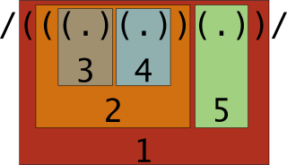
Back-reference
Capture buffer or register ordering
This notion of capture buffers is a very important feature of regular expressions and can be used to solve much harder problems. It will also prove invaluable when we look at substitution

